Slide 1
Go Safe
Hop, Dodge, Survive!

Slide 2







Concept Overview
Core Gameplay Mechanics
Level Structure & Difficulty
UI, Controls, & Audio
Dodging vehicles and drones.
Hop, dodge, and survive!
Navigating hazardous roads and rivers.
Technical Overview & Production
Audio Presentation
Live Gameplay Demonstration
Technical details
Visual and sound design
See the game in action.
References
Reference links
Notes:
References Links to external resources

Slide 3
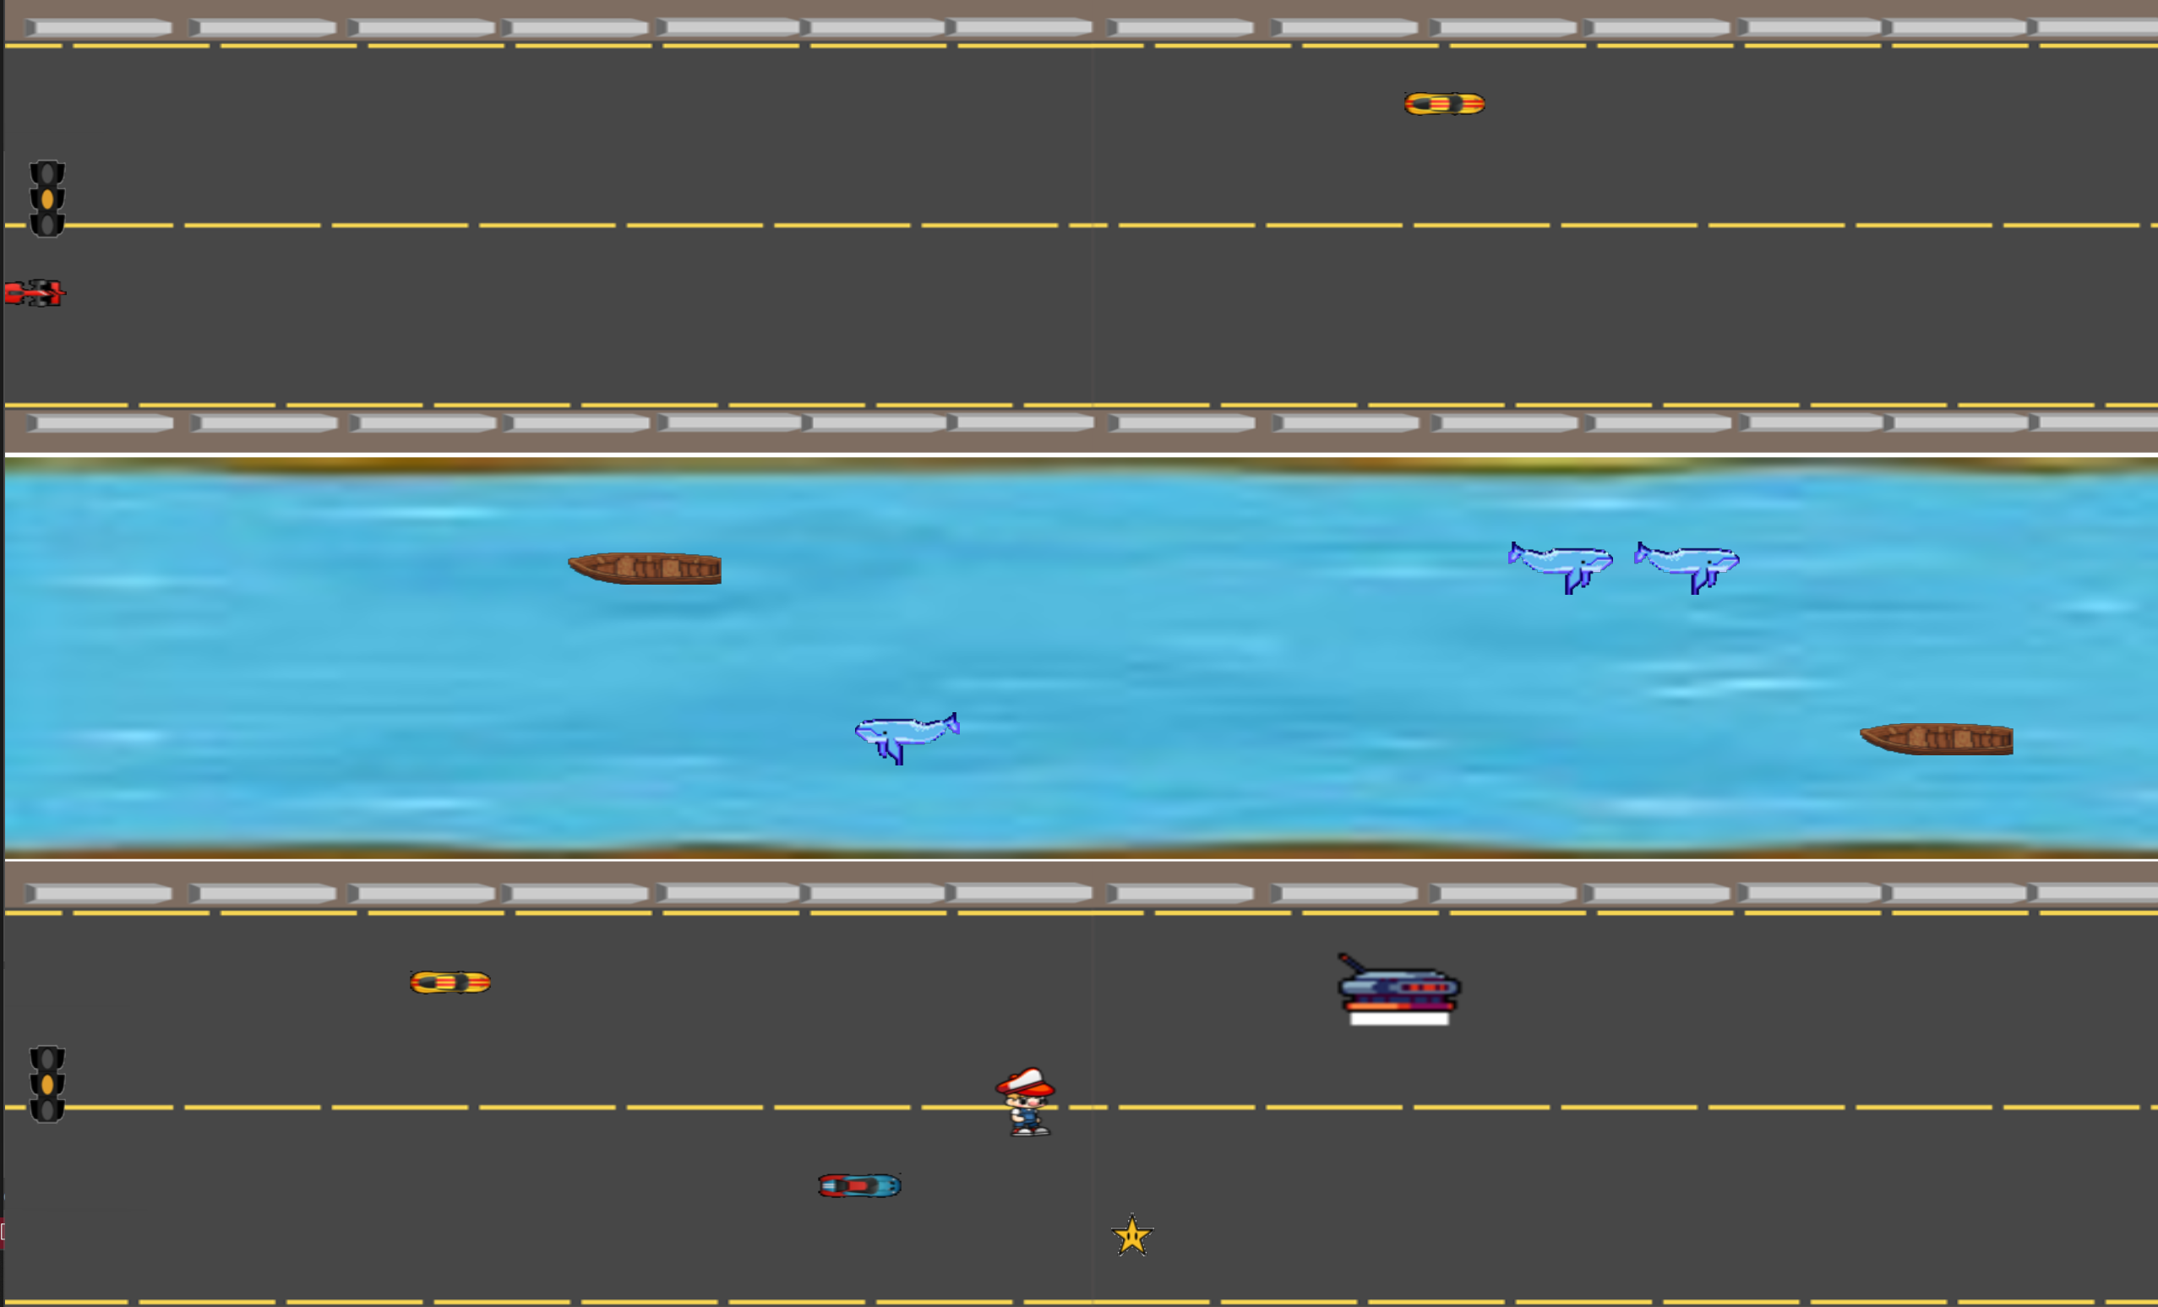
Core Gameplay Mechanics
1
Movement
Use keyboard (W, A, S, D / Arrow keys) and Space for jumping.
2
Traffic Signals
Automated cycle (Green: 3 s, Yellow: 2 s, Red: 2 s) that affect vehicle speed.
3
Safe River Mechanic
Activate a sliding animation via power-up to cross rivers safely.
4
Enemy Behavior
Vehicles adjust speed globally based on signal state. Drones follow the player with an offset and use lasers.

Slide 4
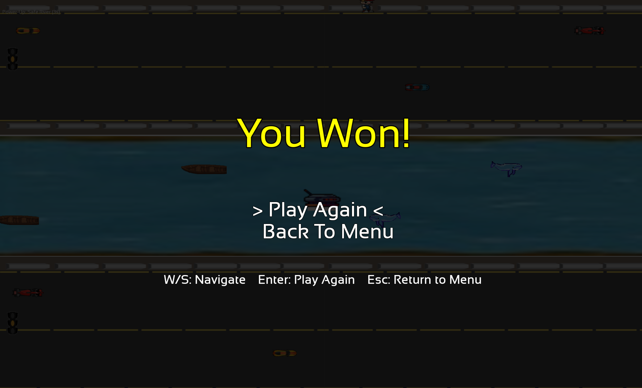
Level Structure & Difficulty
Level 1
Fewer obstacles, slower traffic, a gentle introduction.
Level 2
Increased enemy spawn rates, faster vehicles, heightened challenge.

Slide 5
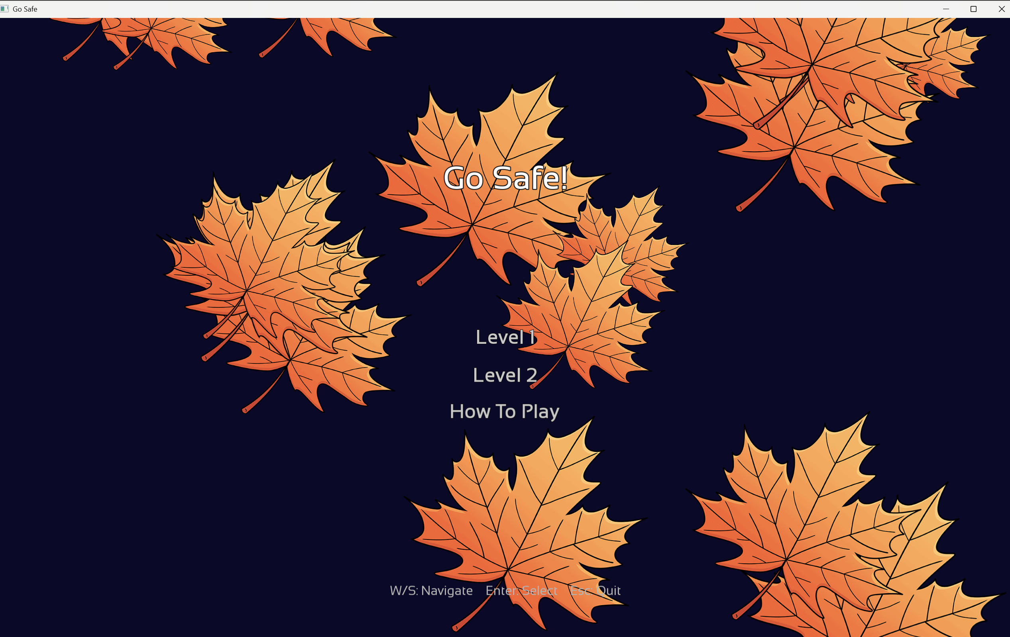



UI, Controls, & Audio
Menus
Clean, modern UI with falling leaves background animations.
Controls
Responsive keyboard controls with W, A, S, D (or arrow keys), Space for jump, ESC to return to the menu, etc.
Audio
Continuous background music on a dedicated channel. Responsive one-shot sound effects (jump, run, collision).

Slide 6




Technical Overview & Production
Development
1
Developed in C++ using SFML, optimized for PC.
Assets
2
Uses texture atlas (gosafe.png) for art assets.
Audio
3
Distinct systems for background music (sf::Music) and sound effects (via MusicPlayer or dedicated SoundPlayer).
Gameplay
4
Robust procedural generation for level elements and dynamic hazard spawning.

Slide 7
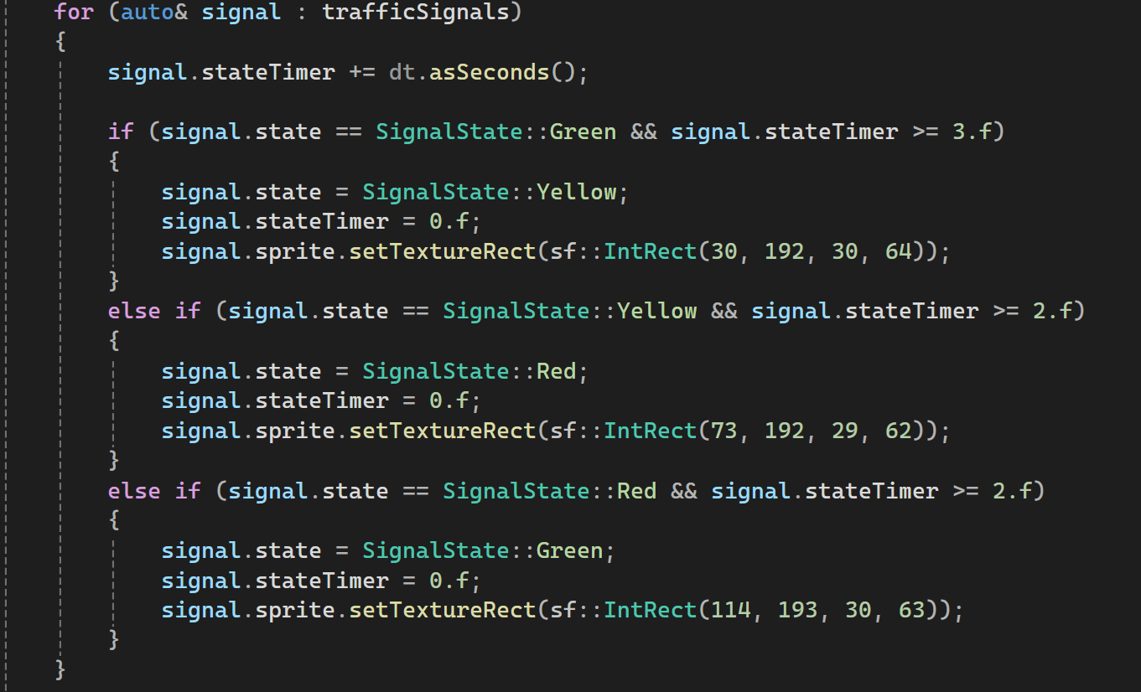
Code Extract: Automated Traffic Signal

Slide 8

Audio Presentation
Music: Go Safe
Sound Effect: Run
Sound Effect: Jump

Slide 9
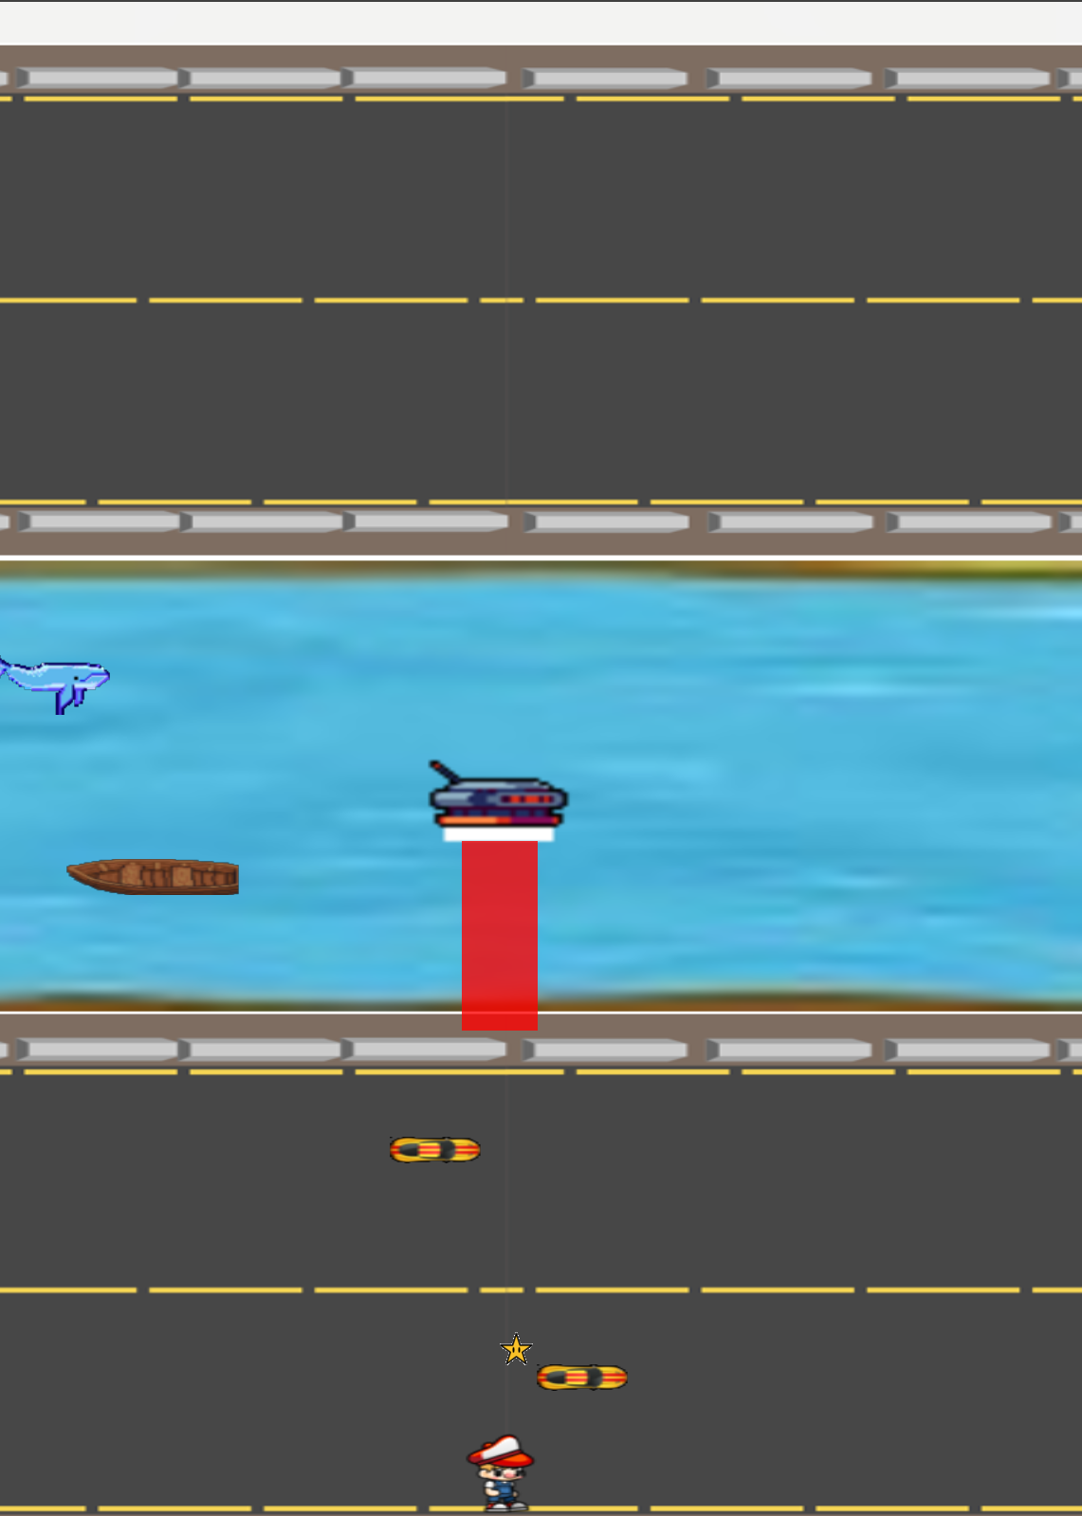
Live Gameplay Demonstration
Level 1
Fewer obstacles, slower traffic, a gentle introduction.
Level 2
Increased enemy spawn rates, faster vehicles, heightened challenge.
Gameplay Mechanics
Automated traffic signals affecting vehicle speed. Safe river sliding, collision, and drone behavior.

Slide 10
References
SFML Documentation: https://www.sfml-dev.org/documentation/2.5.1/
Game Programming Patterns by Robert Nystrom: https://gameprogrammingpatterns.com/
For sound effects: https://pixabay.com/
Sprites: https://itch.io/

